Slide 1
Boosting Lying Posture Classification with Transfer Learning
EMBC’2022

Slide 2
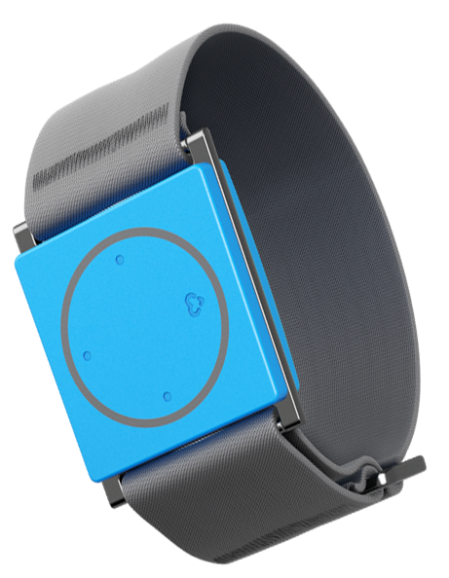
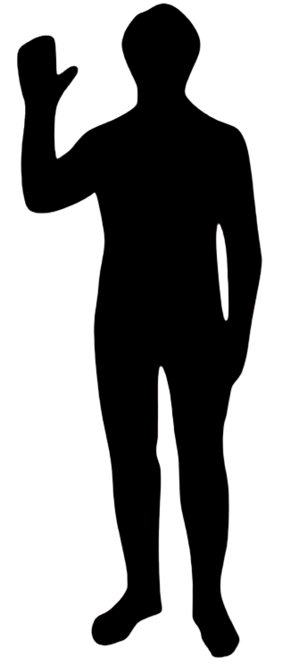
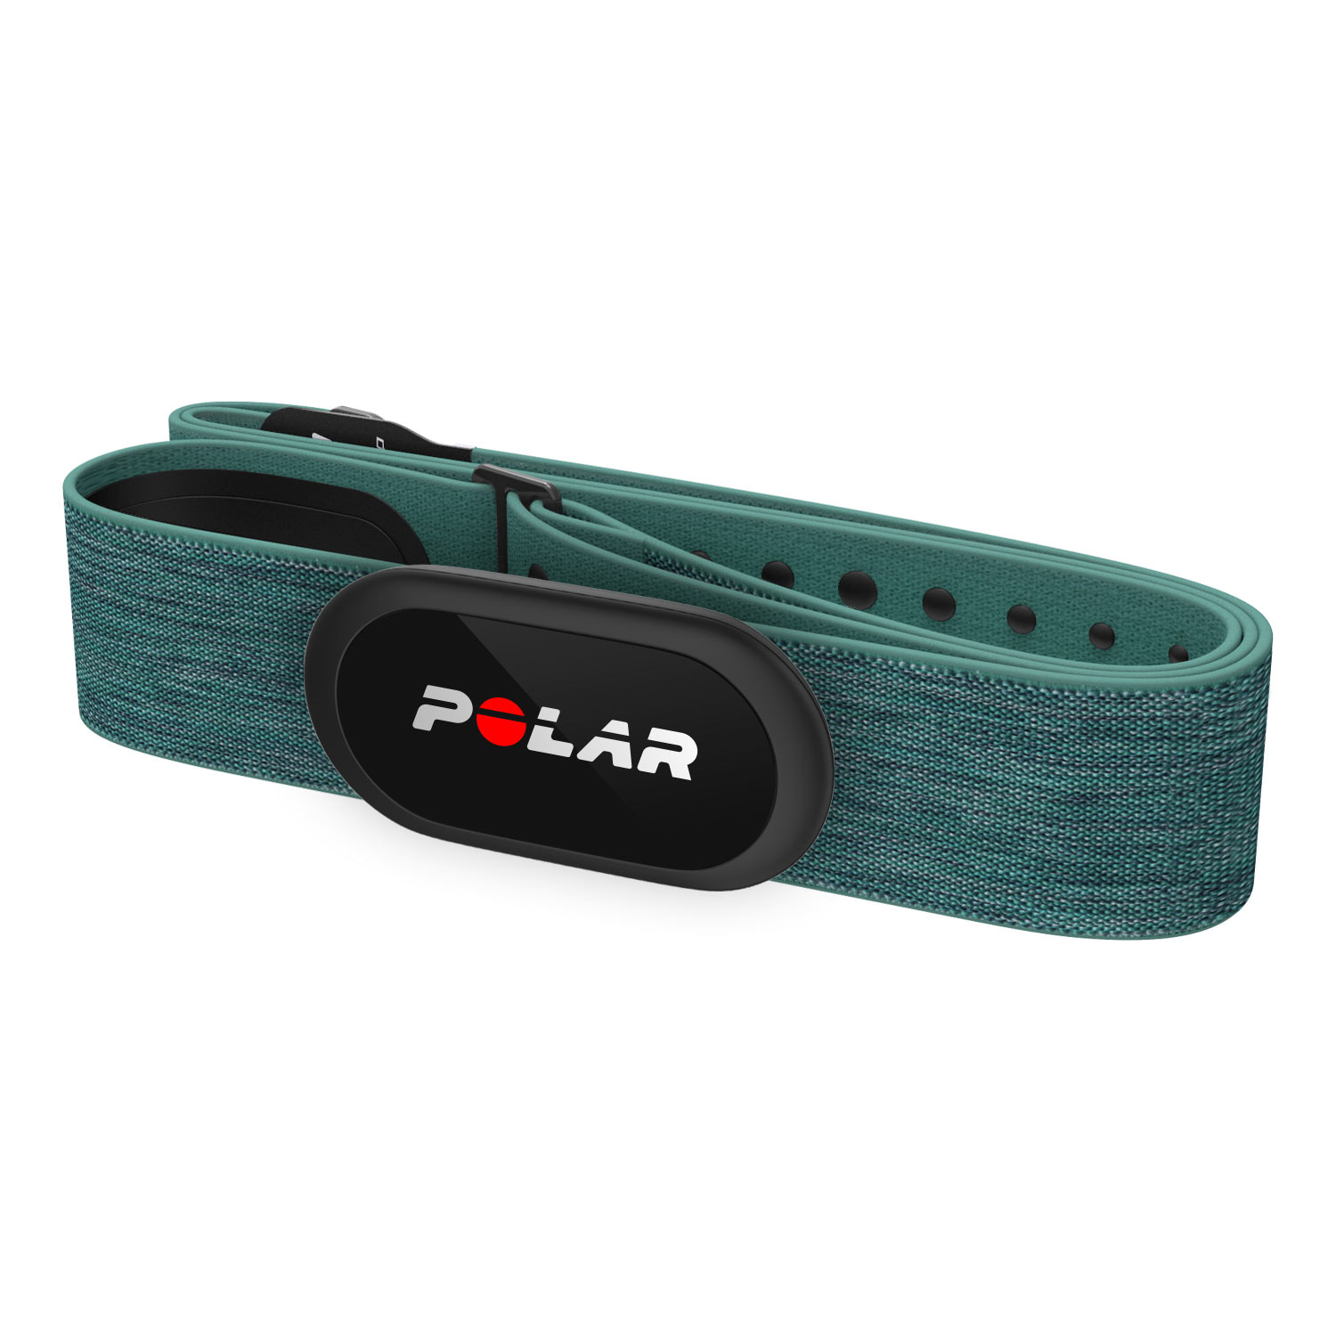
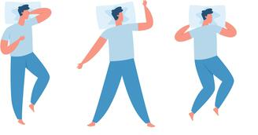
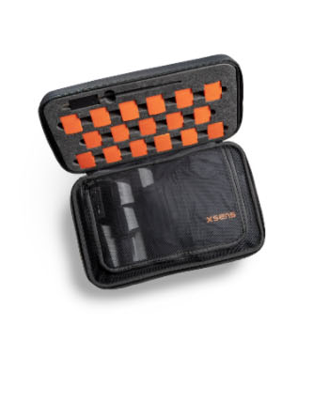
Overview
Chest belts, thigh integrated accelerometers raise some issues which wristbands do not.
Wristband
Lying posture classification
Chest belt
Thigh belt

Slide 3
Why Lying Posture Is Important?
Lying postures provide-
Important clinical information about subjects' mobility
Risk factor for developing hospital acquired pressure injuries
Information of sleep quality

Slide 4
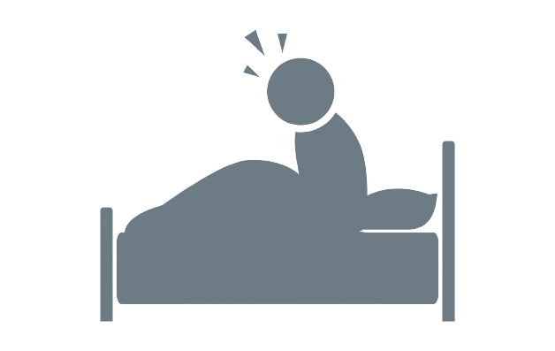



Drawbacks of other instruments
Camera based lying posture
Imposes privacy concerns
Multi-sensor wearable systems
Uncomfortable to wear
Pressure-mats
Expensive to deploy at mass scale
Chest belts
Causes sleep disturbance
Load sensors
Non-invasive but expensive and requires calibration
issues

Slide 5
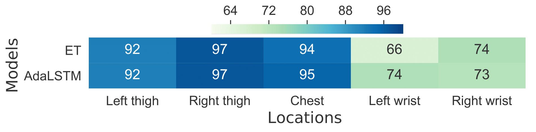
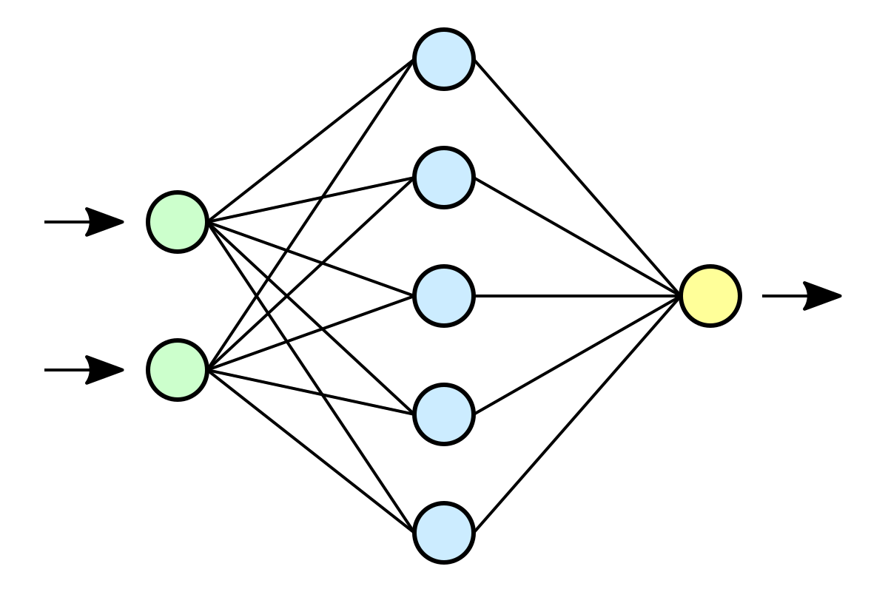
Motivation for Wristband sensor
Wrist worn system guarantees
No privacy issues
No discomfort, easy to carry
No sleep disturbance
Not too expensive
However, directly using wrist worn sensor data raises accuracy issues due to presence of noise
Low accuracy
*ET refers to ensemble tree, AdaLSTM refers to LSTM with adaptive learning rate

Slide 6
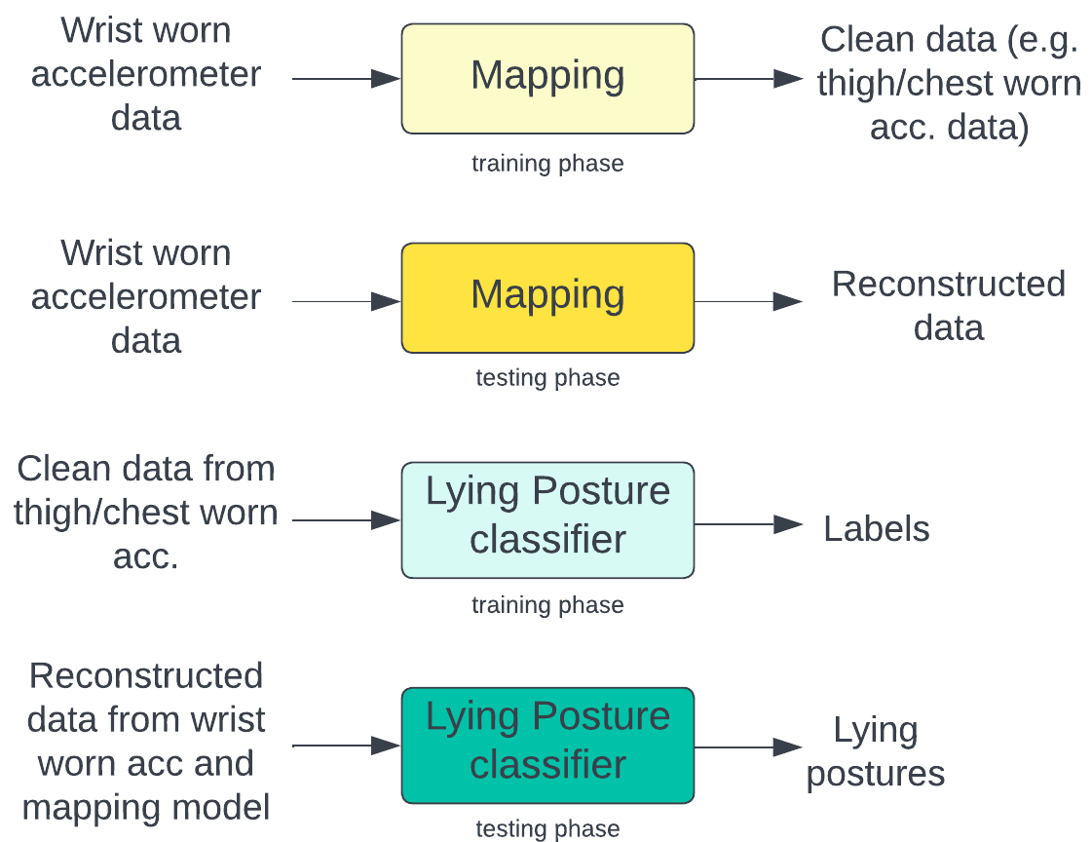
General Framework
or synthetic

Slide 7
General Framework

Slide 8
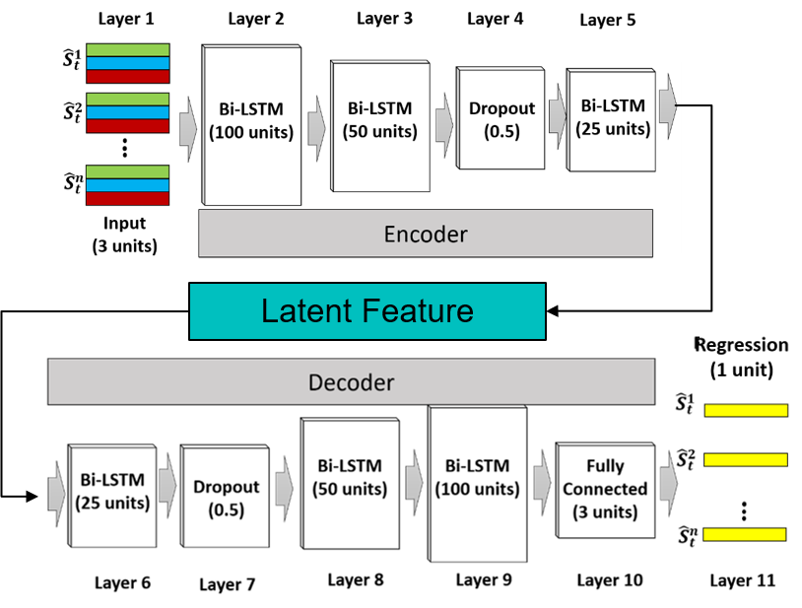
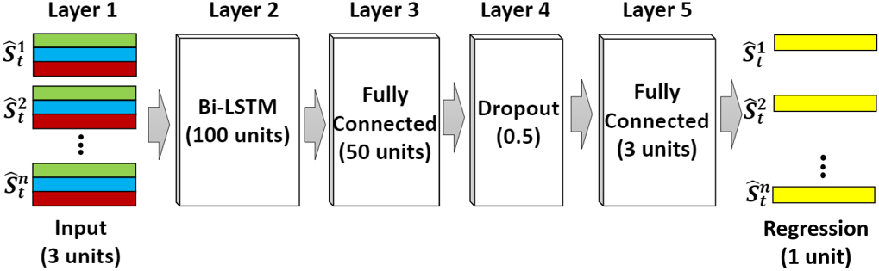
Mapping model
Called sequence to sequence mapping
2 different models were used
LSTM seq2seq Regression
LSTM seq2seq Encoder-Decoder
LSTM seq2seq regression
LSTM seq2seq Encoder-Decoder
Uses bidirectional LSTM to capture data from both direction
6 layers
Aims to minimize RMSE between input and output
Specs: max_epoch=100, Adam optimizer, batch_size=20, lr=0.01, decay rate=0.99
Also uses bidirectional LSTM
11 layers
Aims to minimize RMSE between input X and output X̂
Specs: max_epoch=100, Adam optimizer, batch_size=20, lr=0.01, decay rate=0.99

Slide 9
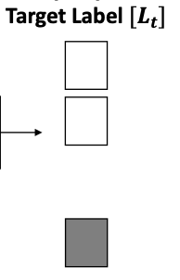
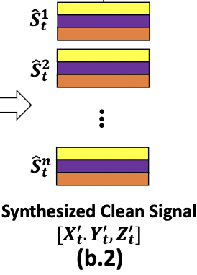

Deep Classifier
AdaLSTM Network
LSTM with adaptive learning rate
Minimizes the classification error
Specifications
Epoch=100, initial lr=0.01, decay rate=0.99,
batch-size=27, Adam optimizer,
softmax output activation
Bi-LSTM
(10 units)
Fully-connected
Fully-connected
Fully-connected
output
softmax

Slide 10
Dataset
2 datasets were used
Class-Act dataset
12 subjects, 9 acc sensors (chest, l-r thigh, l-r ankle, l-r arm, l-r wrist), sampled at 50 Hz
Lying supine, lying prone, lying left side
Combined Class-Act dataset and Daily & Sports Activities dataset
8 subjects, 5 IMU sensors (chest, l-r thigh, , l-r wrist), sampled at 25 Hz
For combining, Class-Act dataset was under sampled
Window size = 20 seconds

Slide 11
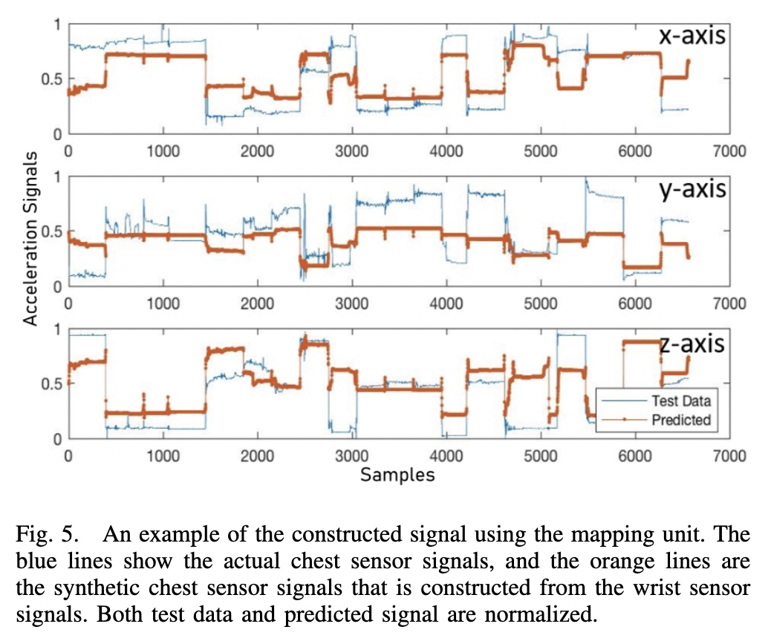
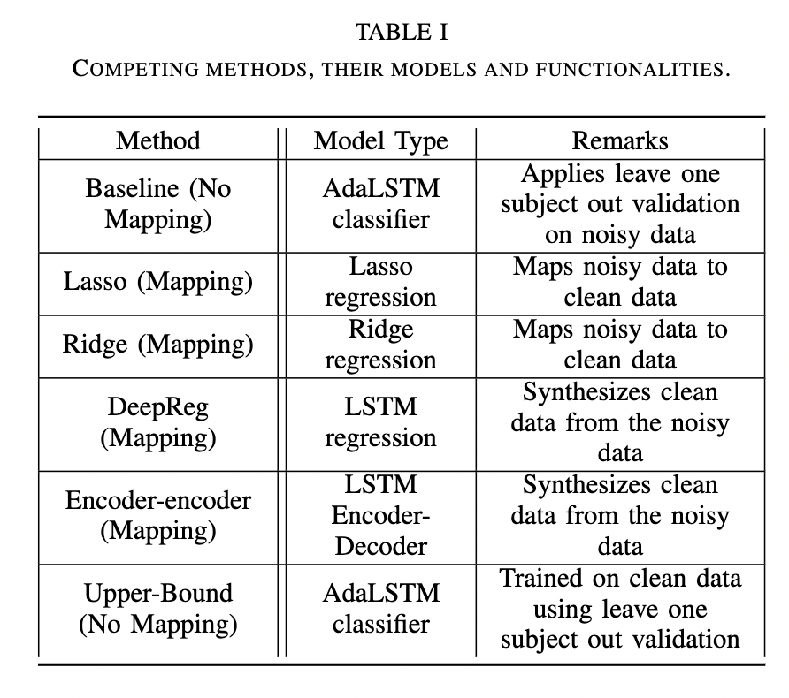
Results

Slide 12
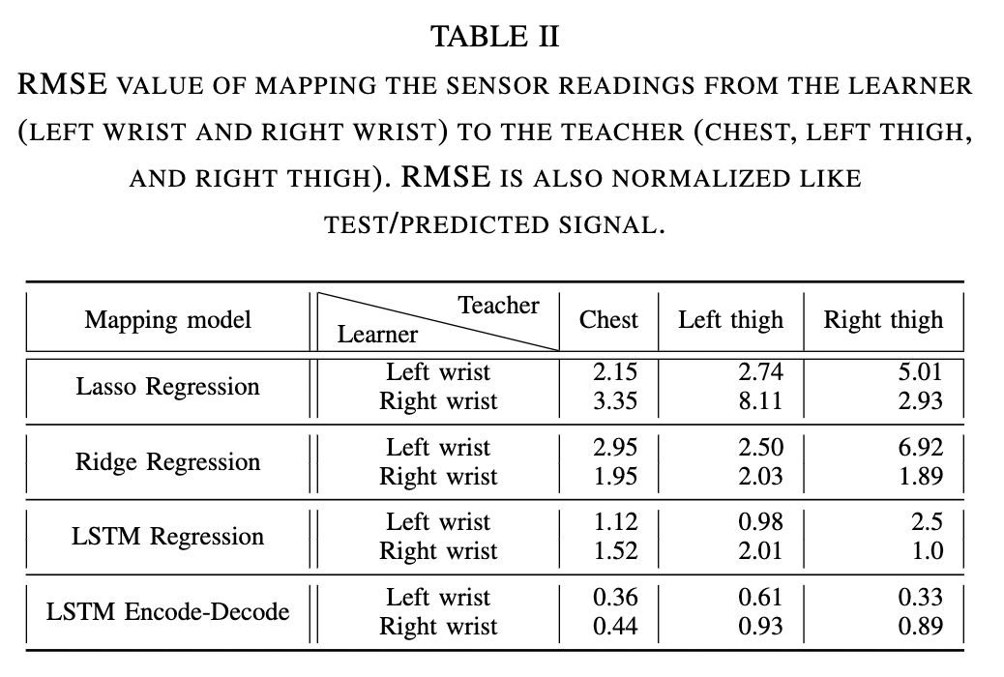
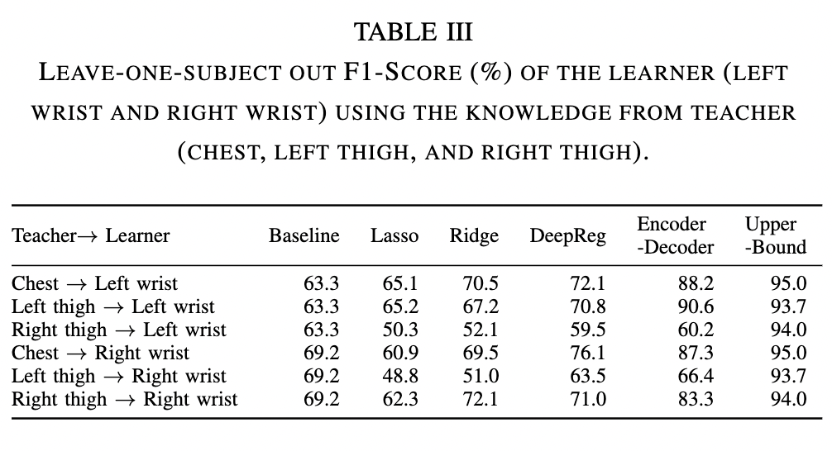
Results

